Slide 1
BUSINESS LETTERS
Ms Madiha.

Slide 2
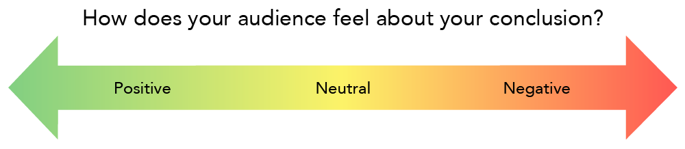
There are communications where the receiver is expected to have a positive or neutral reaction, and there are communications about which receivers may have a more negative reaction.

Slide 3
Types of Business Letters
Positive
Negative

Slide 4
Positive Messages/letters:
Positive messages include messages where the audience is expected to react in a neutral to positive manner. Positive messages tend to consist of routine or good news.
These messages might be items such as congratulations, confirmations, directions, simple credit requests, or credit approvals. Also included in this category might be denials that are somewhat routine or expected.
As strange as this sounds, sympathy messages are in this category as well. Sympathy messages are routine since they will not be a surprise to the receiver.

Slide 5
Consider the message to be a positive message structure when:
The receiver likes or expects this news (product shipped on time)
The receiver needs little education or background to understand the news (travel arrangement for the conference)
The receiver considers the message routine, even if not completely positive (parking lot closed for three days for new striping)

Slide 6
The three main parts of the positive news:
1. Main idea
2. Explanation
3. Motivation/polite closure

Slide 7
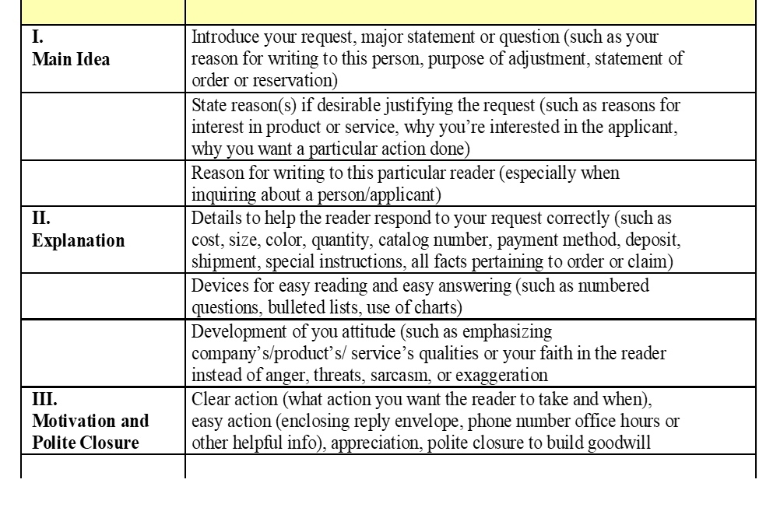

Slide 8
Parts of the Positive News Message Example
Main Point
Your request to open work orders for annual services on vehicles B-BUS and T-TRK has been successfully completed.
Explanation B-BUS has been opened under work order # 13-100 and T-TRK has been opened under work order # 13-101. Please review the attached documentation for accuracy, paying special attention to the vehicle service dates, registration number, and admin number. As of todays date (13th November, 2022), B-BUS and T-TRK have been placed in an “in-shop” status, and are currently being serviced by Mechanic Shop employees. The estimated completion date 1(15th November, 2022) ; however this date may fluctuate dependent on any additional needs of the vehicle. To obtain the current status of the vehicle, please call 1-800-STATS-NOW and enter your vehicle admin number at the prompt. You will be notified via email when the services are complete on each vehicle.
Closure Thank you for your continued patronage of Mechanic Shop, and we hope to continue to assist you in any future service requests.

Slide 9
More Examples of Positive Messages
• It is our pleasure to inform you that we are really looking forward to have this deal with you. Hope to continue our correspondence for the future period.
• The date fixed for our next meeting is Feb 2nd. If you are comfortable with this data, then please ask your secretary to confirm the timing to us by tomorrow.
• It was nice to meet you, and to discuss important aspects of the marketing sectors during the business meeting that was held on May 5th. I look forward to mark my presence to such meetings again in future.
• We thank you for the services and offers that you have provided to us throughout the duration of business contract.
• We are glad to inform you that the business proposal that you have sent to us on April 28th has been appreciated and approved.

Slide 10
Negative Messages/Letters
Negative messages include messages where the audience is expected to react in a negative manner.
Negative messages consist of bad news.
In these messages, the sender’s goal is to convey the bad news in a manner that preserves the business relationship.
While the sender must deliver bad news, the sender wants to avoid an employee quitting or a customer finding another vendor.
These messages might be items such as refusal to provide a refund, cancellation of an event, inability to support an event and more.

Slide 11
Consider the message to be a negative communication when:
The receiver may be displeased (cost for repair is the receiver’s, not the utility company’s)
The receiver needs a little persuasion (new log-on procedure takes longer but is more secure)
The receiver may be somewhat uncomfortable (new badging system underway because employees have been sharing badges)

Slide 12
The four main parts of a negative news message:
1. Buffer or cushion
2. Explanation
3. Negative news
4. Redirect

Slide 14
Parts of the Negative News Message | Example
Buffer or Cushion | Thank you for your order. We appreciate your interest in our product.
Explanation | We are writing to let you know that this product has been unexpectedly popular, with over 10,000 requests on the day you placed your order.
Negative News | This unexpected increase in demand has resulted in a temporary out-of-stock/backorder situation. We will fulfill your order, received at 11:59 p.m. on 15th December, 2022, in the order it was received.
Redirect | We anticipate that your product will ship next Monday. While you wait, we encourage you to consider using the enclosed $5 off coupon toward the purchase of any product in our catalog. We appreciate your business and want you to know that our highest priority is your satisfaction.

Slide 15
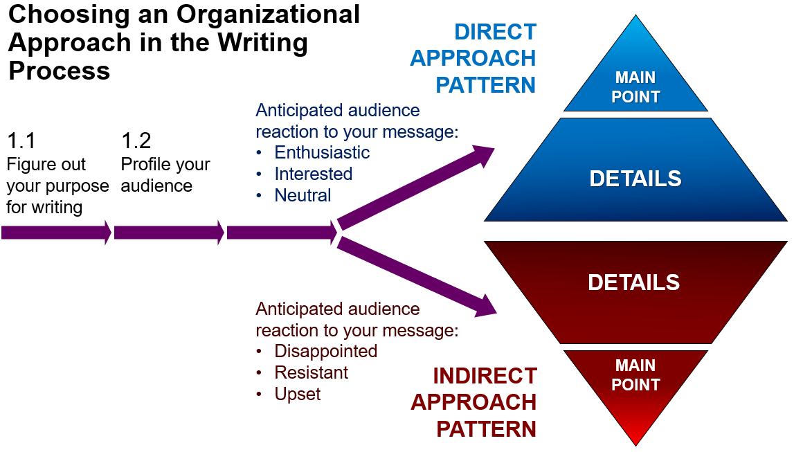

Slide 16
Essentials of Business Letters:
Developing Effective Tone: Business correspondence should have a tone that sounds natural and conveys cooperation, mutual respect, sincerity, and courtesy. Create a pleasant and cooperative tone in your correspondence.
Natural language: Use simple, clear, and natural language. Avoid using old-fashioned phrases that sound artificial.
Positive Language: Keep the emphasis on positive rather than negative images. Stress on the positive rather than negative aspects of a situation.

Slide 17
Negative: When I received your complaint, I checked our records.
Positive: When I received your letter, I checked our records.
Negative: I am sending a replacement for the faulty coil.
Positive: I am sending a new coil that is guaranteed for one year.
Negative: Do not let carelessness cause accidents in the testing laboratory.
Positive: Please be careful when handling explosive compounds.

Slide 18
You-Attitude: The you-attitude refers to the point of view a writer takes when looking at a situation as the reader would. Information is presented from the standpoint of how it will affect or interest your reader.
Writer Emphasis: We are shipping your order on Friday.
Reader Emphasis: You will receive your order by Monday.
Writer Emphasis: I was pleased to hear that the order was completed.
Reader Emphasis: Congratulations on successfully completing the project.
For you-attitude, do the following:
Emphasize reader’s benefits in a situation.
Be pleasant.
Offer a helpful suggestion or appreciative comment when possible.
Do not choose insulting or words for your readers.

Slide 19
Example of Negative Message/Letter:
Good morning Mr. Johnson, this is Roberta Brown at Mechanic Shop, writing regarding your recent interview for a job opening in our facility. I regret to inform you that you were not selected for the Inspection Supervisor position. While you skills and prior accomplishments were excellent, the selection board was concerned with your lack of supervisory experience and short job history. Supervisory experience is a key skill, one which is greatly needed on the inspection team.
Thank you for your interest and I wish you continued success on your career path.
I encourage you to apply to any applicable job openings we may have in the future.

Slide 20
Letter format Full Block Format
In a full block business letter, every component of the letter (heading, address, salutation, body, salutation, signature, identification, enclosures) is aligned to the left.
Also, first sentences of paragraphs are not indented.
You will see that there are two spaces between the address and the date; three spaces between the address and the salutation; two spaces between the salutation and the first body paragraph; two spaces between first, second, and third body paragraphs; two spaces between the body, the complimentary close, the signature line, identification, and enclosures.

Slide 21
HEADING (your address and date) ADDRESS (of the person you are writing to) SALUTATION BODY COMPLIMENTARY CLOSE IDENTIFICATION LINE TITLE OR PHONE NUMBER SIGNATURE ENCLOSURES OR DISTRIBUTION | 20-54 Jackson Avenue Brooklyn, NY 11352 June 28, 2007 Ms. Jennifer Esposito John Doe Fellowship 595 Park Avenue New York, NY 10021 Dear Ms. Esposito: The John Doe Fellowship has always loomed on the horizon for me. Ever since I decided to major in history, I have wanted to participate in your program. From the research that I have done, I believe that your program provides its participants with an extensively detailed look at the history of the world through hands-on experience with fossils, artifacts, and other remains that compose the blueprint of our existence. I am applying for the John Doe Fellowship because I believe that it would benefit me throughout my career and allow me to further understand the ideas behind history and how it is constructed. I am a very committed and goal-oriented person with excellent interpersonal skills. My background in history involves studying many different eras and time periods. My specialty, though, is the archeological study of the ancient world and its history. During the summer of 2004 and 2005, I interned at the Metropolitan Museum of Art as a tour guide. Both times, I not only utilized my knowledge of art and its history, but I also learned a lot about how that history was constructed. This experience has influenced me to intern as a tour guide at the American Museum of Natural History, where my love for the origins of history and learning from the tactile experience with artifacts increased. In the future, I would like to participate in historical research and eventually become a full-time professor of history. I believe my skills, experience, and goals make me an excellent candidate for your program. Thank you very much for considering me for the John Doe Fellowship. I am looking forward to hearing from you. Sincerely, Bill Lurie (419) 352-5425 Enclosure

Slide 22
Tips for Writing Business Letters Effectively:
• Remember to use formal language and avoid any typographical errors.
• Start the letter with a friendly opening.
• State your reason for writing a business letter.
• Always have an idea to whom you are writing.
• Specify necessary details like time, date venue etc.
• Be to the point and straight forward.
• Write the letter with a polite tone but avoid being overtly personal.
• Keep the letter short and concise and with specific details.
• Do not write long introductions and unnecessary statement.
• Check for grammatical errors and spelling mistakes.
• Avoid usage of slangs or messaging language as that does not indicate professionalism.
• Cut useless words, needless information, and stale phrases.
• Use familiar words, short sentences and paragraphs, and a simple conversational style.
• Write as if you were talking to the reader, and be as friendly as possible.
• If possible the business letter should not be hand written and should be typed as it looks more professional and the letters are visible.
• Close the letter by thanking the person for their time and consideration

Slide 23
Practice exercise
1. Sales have decreased for two consecutive quarters at your business. You have been instructed to inform your sales team that their hours, and base pay, will be reduced by 20 percent. While you may have a few members of your sales team that are underperforming, you want to retain the entire team. Write a negative news message in a direct or indirect approach informing your sales team of the news.
2. You have observed and documented an employee being late and taking long breaks for the past two weeks. Write out a brief summary of the conversation you need to have. You may be assigned to another classmate for a role-playing exercise. Share and compare with your classmates.
3. Write a follow-up letter thanking a customer for his or her business. The letter should be brief, direct, and courteous.
4. Write a letter of application to a company that has advertised an opening for a job that interests you. Clearly state your interest and qualifications. Be brief and to the point. Be sure to proofread the letter carefully and correct any careless errors.

